Slide 1
City of West Covina Redistricting 2021 1st Public Workshop
National Demographics Corporation

Slide 2
Tonight’s Agenda
The 2021 redistricting process
Project timelines
Key deadlines
Next steps and hearings
2020 US Census data updated demographics

Slide 3
Why do Cities go Through the Redistricting Process?
To review the 2020 US Census Bureau data
To ensure compliance with applicable federal and California voting laws

Slide 4
West Covina Elections
Council Members hold 4 -year terms
Districts 2, 4 & 5 terms end November 2022
Districts 1 & 3 terms end November 2024

Slide 5
Redistricting Process
Step | Description
Two Initial Meetings November 18 & December 7 | Held prior to release of draft maps. Education and to solicit input on the communities in the Districts.
US Census Data Release Mid-August | Census Bureau released official 2020 Census population data.
California Data Release Late September 2021 | California Statewide Database released California’s official ‘prisoner-adjusted’ 2020 redistricting data.
Two Draft Map Hearings TBD | Two Public Hearings to discuss and revise the draft maps and to discuss the election sequence.
Map Adoption By April 17, 2022 | Final map must be posted at least 7 days prior to adoption. Map adopted via ordinance

Slide 6
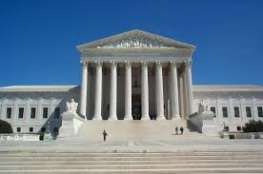
Redistricting Rules and Goals
1. Federal Laws
2. California Criteria
for Cities
3. Other Traditional Redistricting Principles
Equal Population
Federal Voting Rights Act
No Racial Gerrymandering
Geographically contiguous
Undivided neighborhoods and “communities of interest” (Socio-economic geographic areas that should be kept together)
Easily identifiable boundaries
Compact (Do not bypass one group of people to get to a more distant group of people)
Prohibited:
“Shall not favor or discriminate against a political party.”
Minimize voters shifted to different election years
Respect voters’ choices / continuity in office
Future population growth
Preserving the core of existing districts

Slide 7
Demographic Summary of Existing Districts
West Covina Existing Districts - 2020 Demograpghics
District |  |  |  | 1 | 2 | 3 | 4 | 5 | Total
Total Population |  | Total Pop |  | 22,059 | 21,959 | 22,279 | 21,671 | 21,888 | 109,856
 |  | Deviation from ideal |  | 88 | -12 | 308 | -300 | -83 | 608
 |  | % Deviation |  | 0.40% | -0.05% | 1.40% | -1.37% | -0.38% | 2.77%
 |  | % Hisp |  | 62.50% | 58% | 56% | 48% | 41% | 53%
 |  | % NH White |  | 11% | 11% | 10% | 12% | 10% | 11%
 |  | % NH Black |  | 3% | 4% | 4% | 4% | 4% | 4%
 |  | % Asian-American |  | 22% | 26% | 28% | 35% | 43% | 31%
Citizen Voting Age Pop |  | Total |  | 13,585 | 14,681 | 15,441 | 13,524 | 14,784 | 72,015
 |  | % Hisp |  | 62% | 55% | 53% | 43% | 38% | 50%
 |  | % NH White |  | 15% | 17% | 13% | 18% | 15% | 16%
 |  | % NH Black |  | 3% | 4% | 7% | 7% | 6% | 5%
 |  | % Asian/Pac.Isl. |  | 19% | 23% | 26% | 32% | 41% | 28%
The data set above uses 2020 official Census data
for each of West Covina’s existing districts.

Slide 8
West Covina’s Current Districts are Population Balanced
West Covina’s existing districts are population balanced using the 2020 Census data
NDC is reviewing the districts to see if they are in compliance with applicable federal and state voting laws
If West Covina determines that there are no issues with federal and state voting laws, the Council can make a decision:
Continue redistricting process to consider changes to neighborhoods and communities of interest (if any) and refine the current district lines? OR
Keep the current districts as-is?
Regardless of the Decision: West Covina must still hold the four required hearings and pass an ordinance to adopt district boundaries (either current or changed) by April 17th

Slide 9
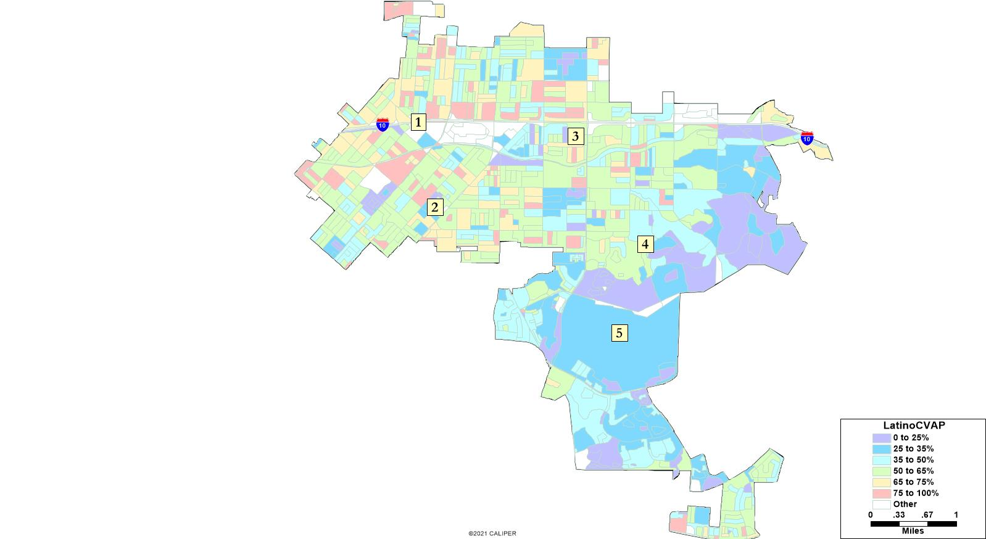
Latino CVAP

Slide 10
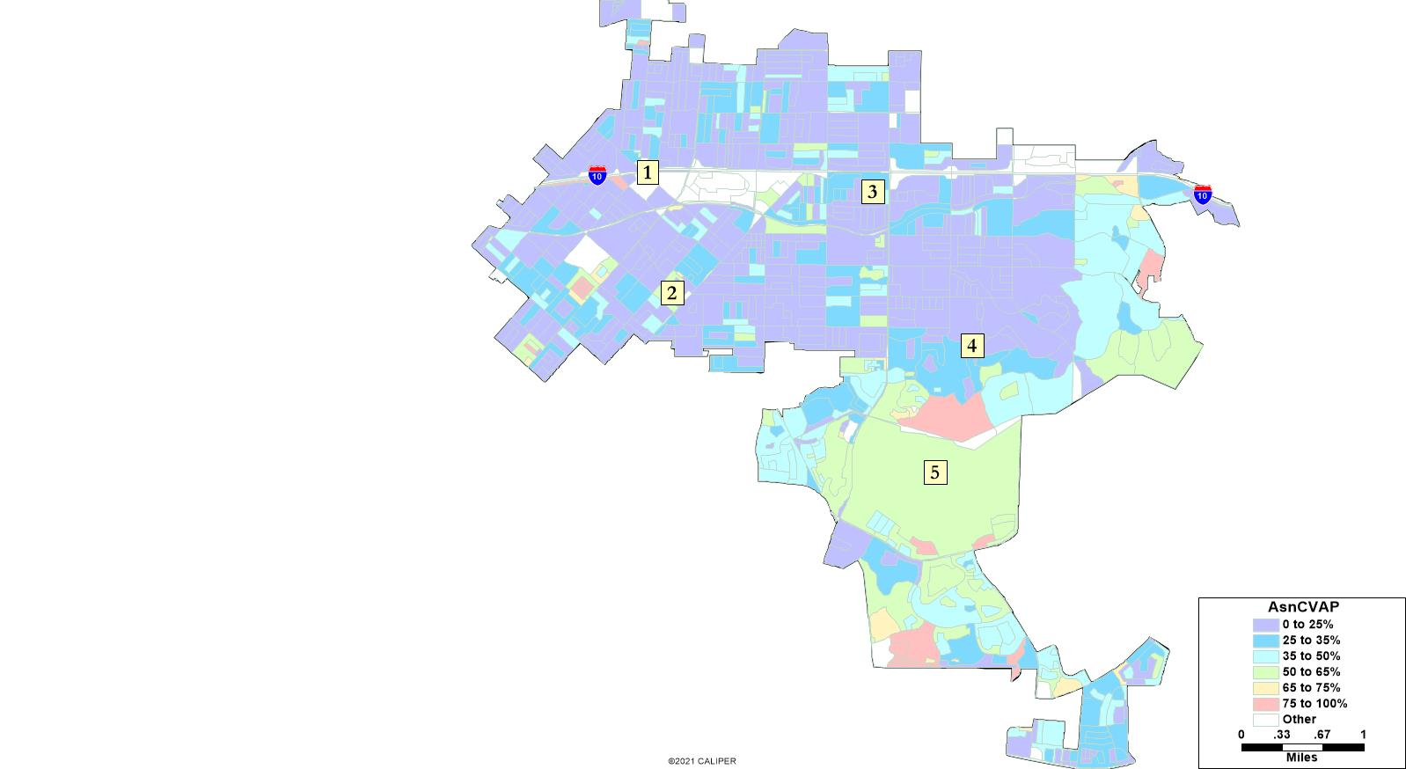
Asian American CVAP

Slide 11
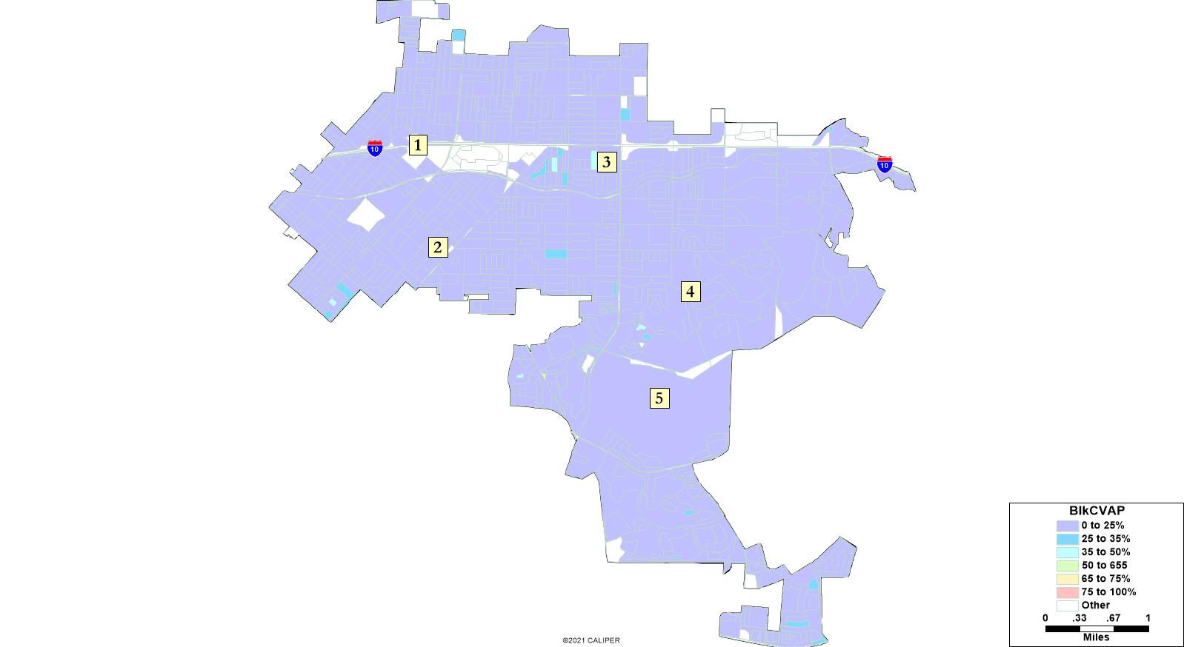
African American CVAP

Slide 12
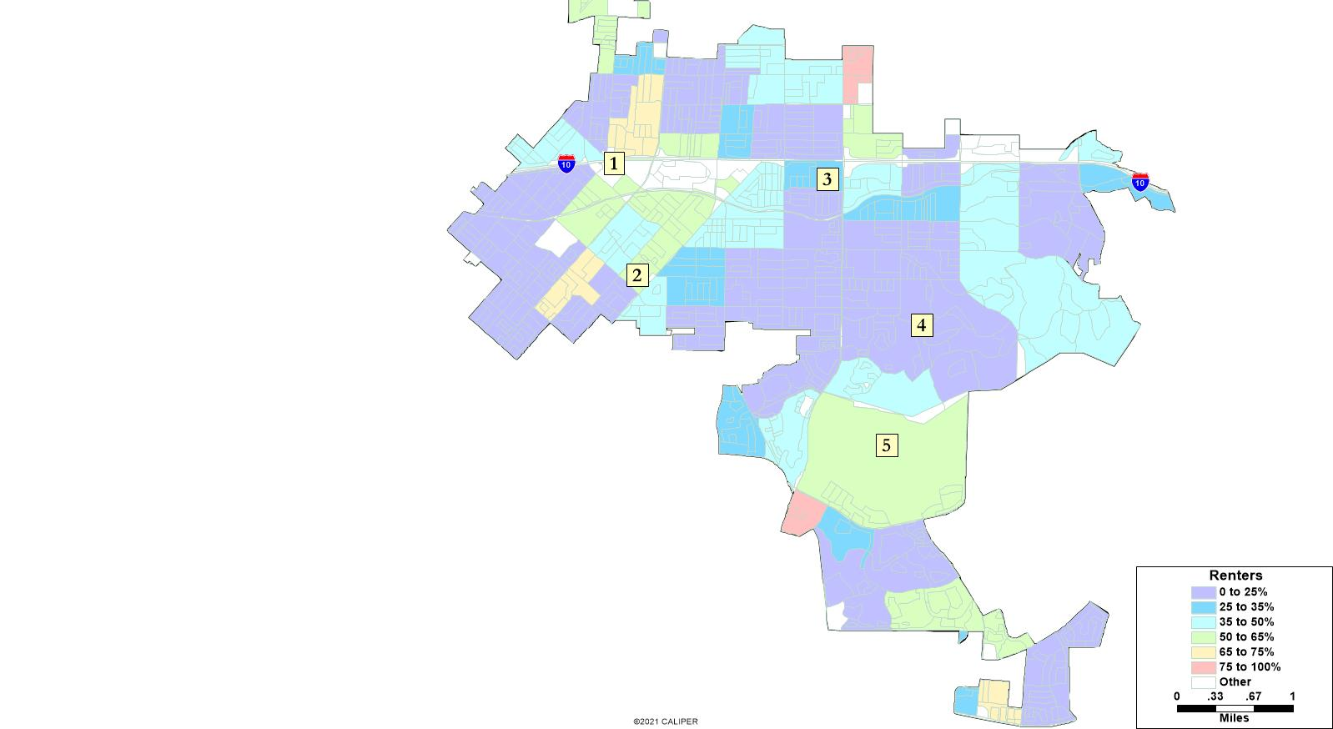
Percentage Renters

Slide 13
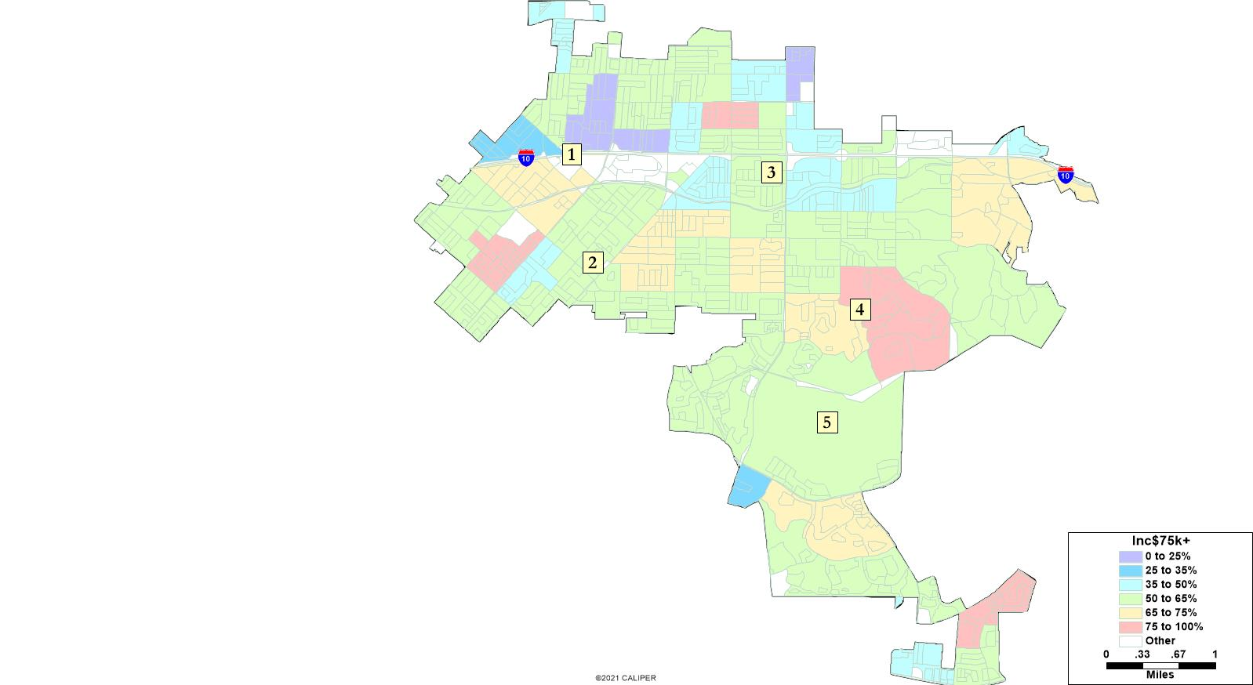
Income Statistics

Slide 14
Defining Neighborhoods
1st Question: What is your neighborhood?
2nd Question: What are its geographic boundaries?
Examples of physical features defining a neighborhood boundary:
Natural neighborhood dividing lines, such as highway or major roads, rivers, canals and/or hills
Areas around parks or schools
Other neighborhood landmarks
In the absence of public testimony, planning records and other similar documents may provide definition.

Slide 15
Beyond Neighborhoods: Defining Communities of Interest
1st Question: what defines your community?
Geographic Area, plus
Shared issue or characteristic
Shared social or economic interest
Impacted by city/county policies
Tell us “your community’s story”
2nd Question:
Would this community benefit from being “included within a single district for purposes of its effective and fair representation”?
Or would it benefit more from having multiple representatives?
Definitions of Communities of Interest may not include relationships with political parties, incumbents, or political candidates.

Slide 16
Possible Neighborhoods / Communities
Possible Neighborhoods / Communities
Freeway Corridor & Commercial areas
Azusa Avenue corridor
HOAs or neighborhoods
Other areas

Slide 17
Tonight’s Discussion
Next Steps:
Provide NDC with feedback on:
Areas that meet each AB 849 definition for neighborhoods and communities of interest.

Slide 18
Key Dates and Next Steps
August/September 2021 | Redistricting data available. Census data released in mid-August. California released prisoner-adjusted data late September.
November 18, 2021 | 1st Public Workshop (counts as a hearing for AB 849 requirements)
December 7, 2021 | 2nd Public Hearing
TBD | Proposed 3rd Public Hearing
TBD | Ordinance introduction hearing
TBD | Ordinance adoption hearing. Must be completed no later than April 17, 2022.
April 17, 2022 (E-205) | City deadline to adopt and submit map to Registrar
November 2022 | 2022 Election

