Slide 1
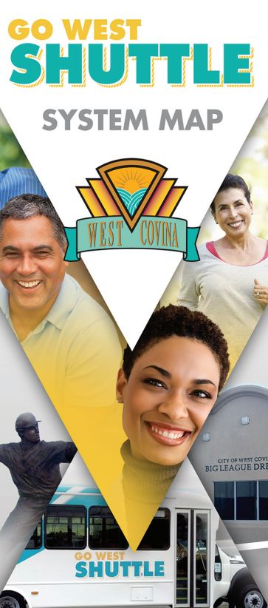

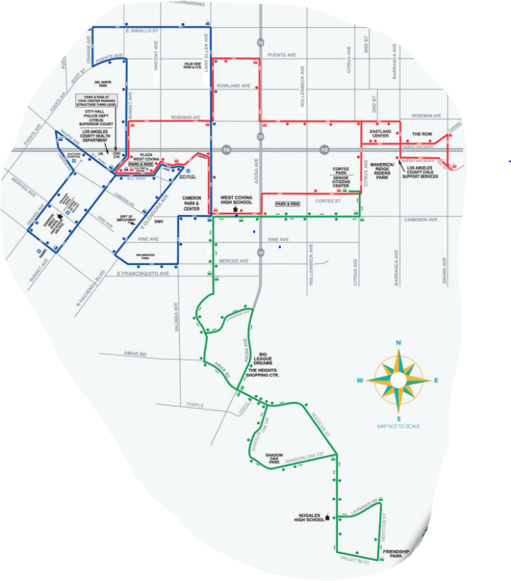

Transit Service Evaluation
City of West Covina
February 2022

Slide 2
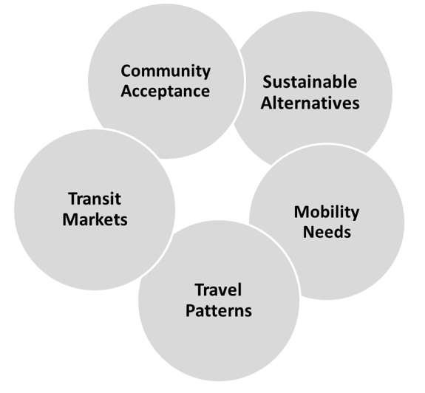

Agenda
Overview of Project Objectives & Work Plan
Service Evaluation
What We Heard?
An Evolving Mobility Landscape
Service Improvement Strategies – IDEAS
We Need Your Input!
2

Slide 3
Overview of Project – Transit Service Evaluation
Important step in the COVID-19 recovery phase
Detailed evaluation of the existing Go West services
Target to:
  Provide better transit services
  Grow ridership base & users of transit services
  Respond to changing customer expectations (& demand
  Identify financially sustainable changes (with existing resources)
Recommend specific service modifications
Existing & future conditions
New technologies
Changing demographics
3

Slide 4


Project Work Plan
Investigation – Review and understand the unique conditions of the diverse and varied constituencies of West Covina’s service area. Analysis of current transit service performance.
Innovation – identify and analyze service enhancements (& mobility solutions), vet these with the community.
Solutions – develop an action and implementation plan, describing proposed deployment plan and its benefits.
Robust Analytical and Evaluation Process
Apply Industry Knowledge
Look Ahead
Be Pragmatic
4

Slide 5

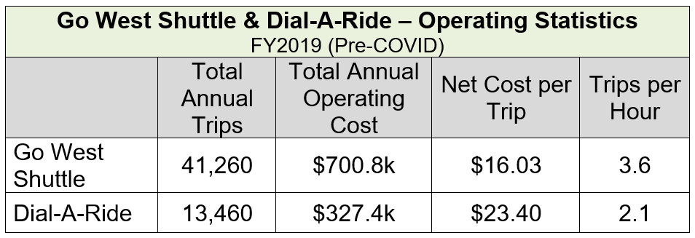
Service Analysis
Go West Shuttle: (x3 routes)
Mon.-Fri. – 6:30a.m – 7:00p.m.
$1. fare
Dial-a-Ride:
Shared ride curb-to-curb service
Persons with disabilities and 55+
$.50 fare
5

Slide 6
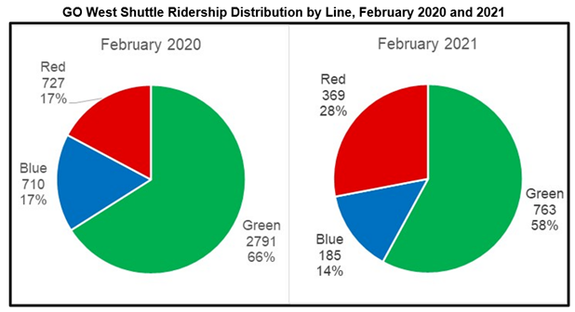
Service Analysis
6

Slide 7
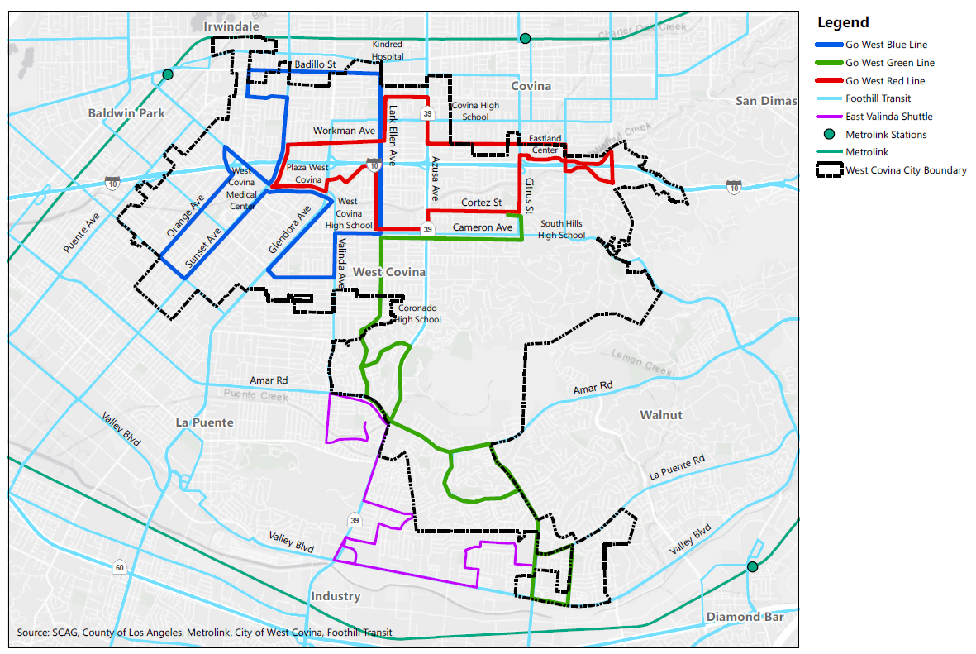
Service Analysis
Current transit services:
Go West Shuttle routes
Foothill Transit routes
East Valinda Shuttle
Metrolink
7

Slide 8
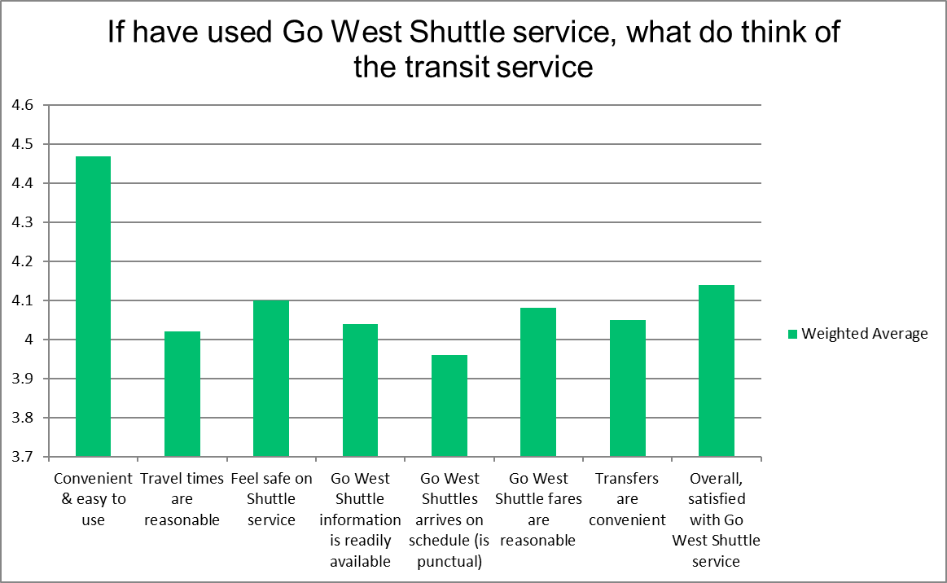
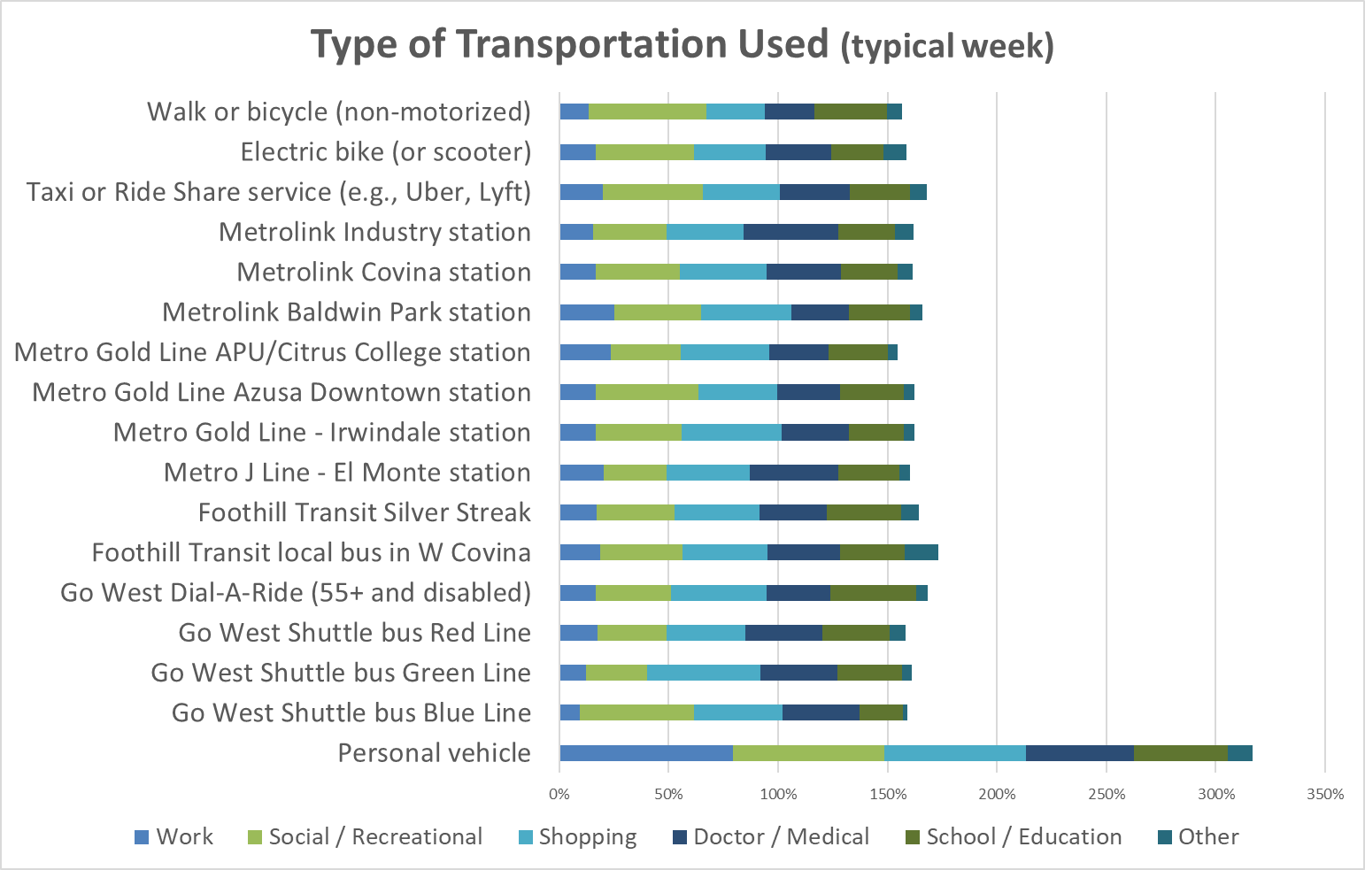
What We Heard
Community Survey: 549 completed responses
Of survey respondents who have used Go West Shuttle service:
80+ % are satisfied with service
87% indicated convenient & easy to use
8

Slide 9
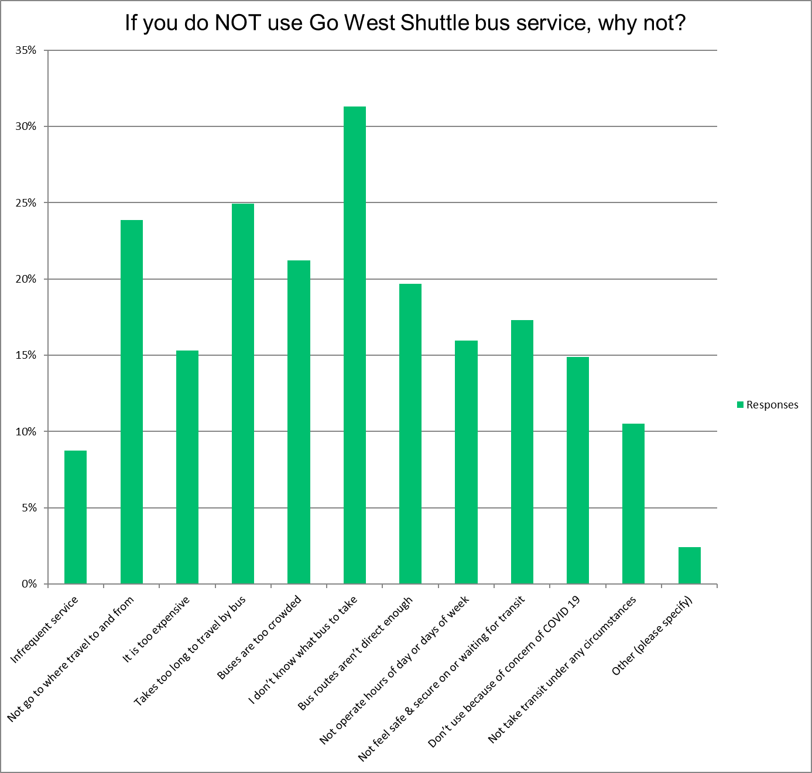
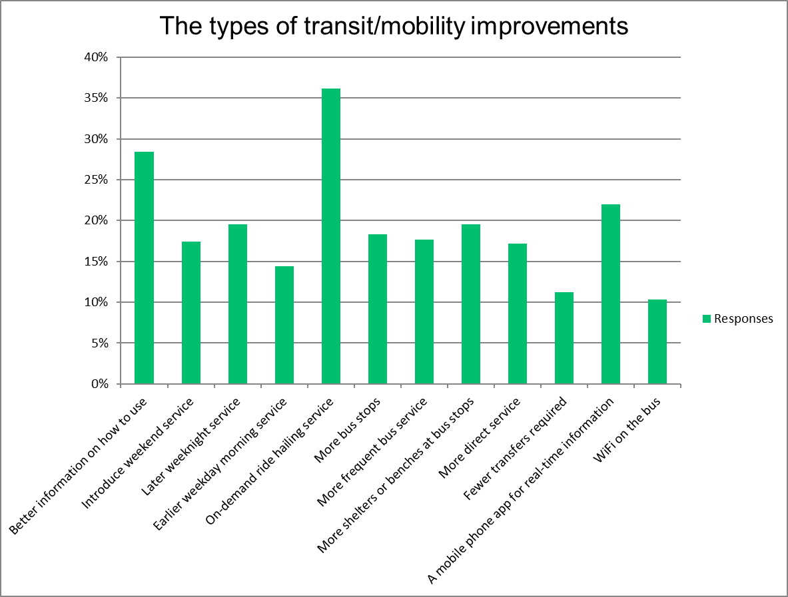
What We Heard
Not Use:
Types of Improvements
On Demand ride hailing service
Better info how to use
Not know what bus to take
Takes too long
Not go where travel to & from
Routes not direct enough
Mobile app – real-time info
Later evening service
More stops (& benches/shelters)
9

Slide 10
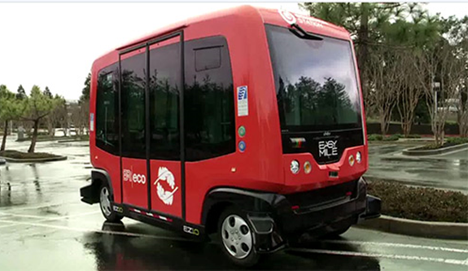

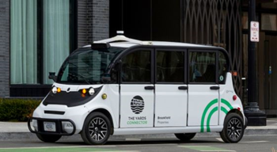
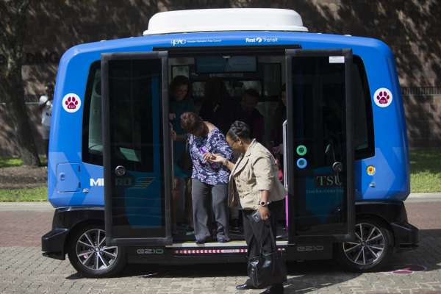
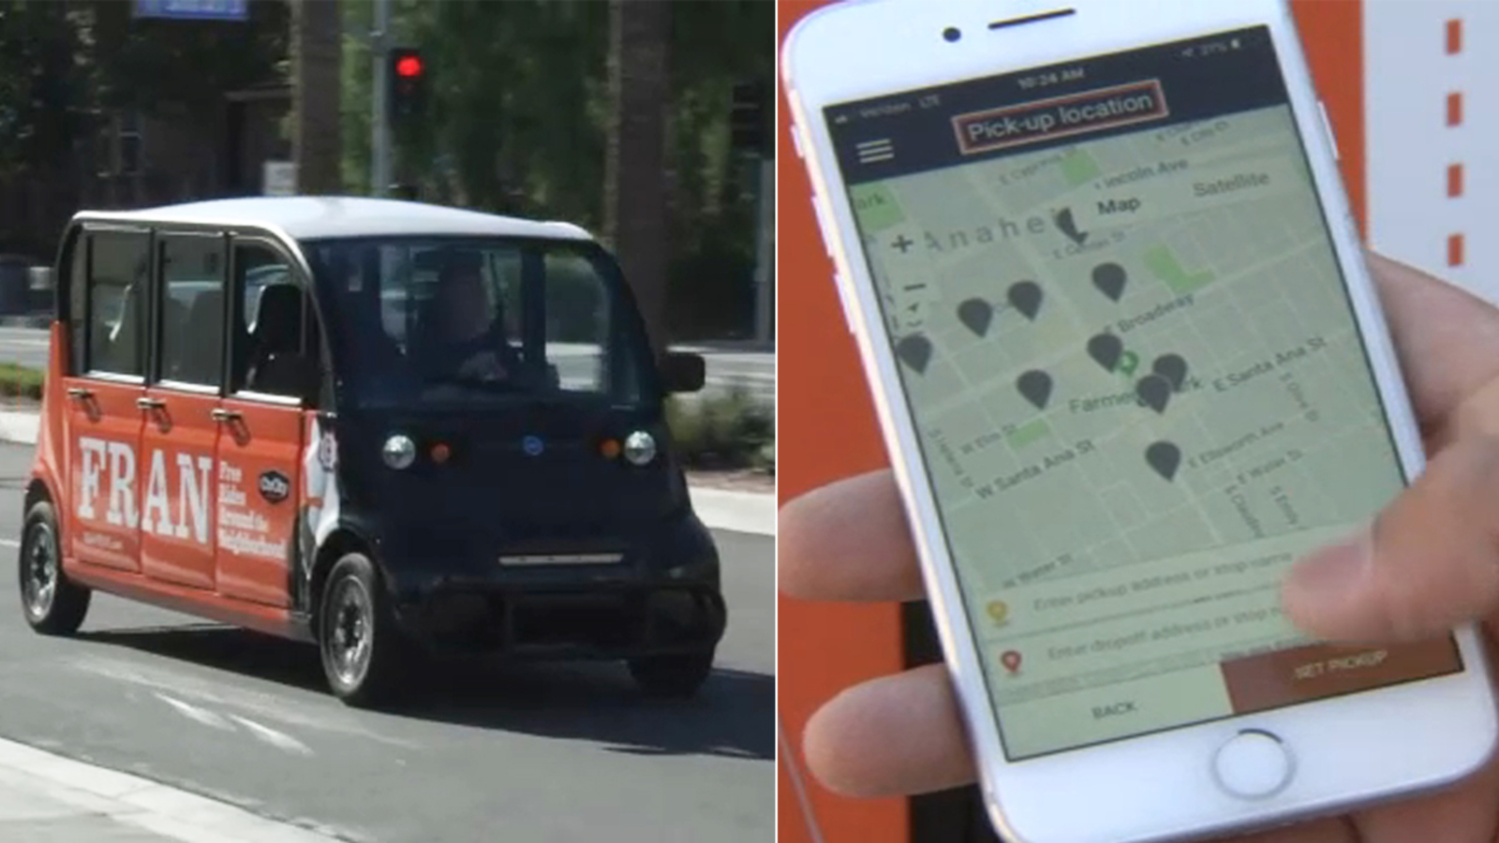
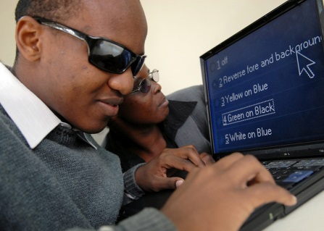

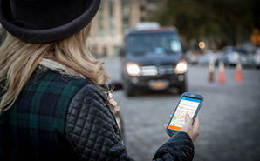
Evolving Mobility Landscape
Next-Generation mobility options
Advanced Technologies
  E-hailing / App based scheduling and payment
  Estimated pickup-time and ride cost
  Manage online accounts
  Connection to customer service and driver
10

Slide 11
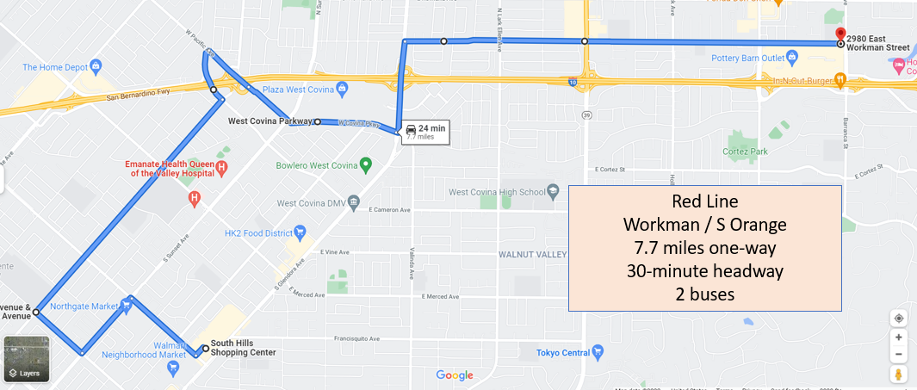
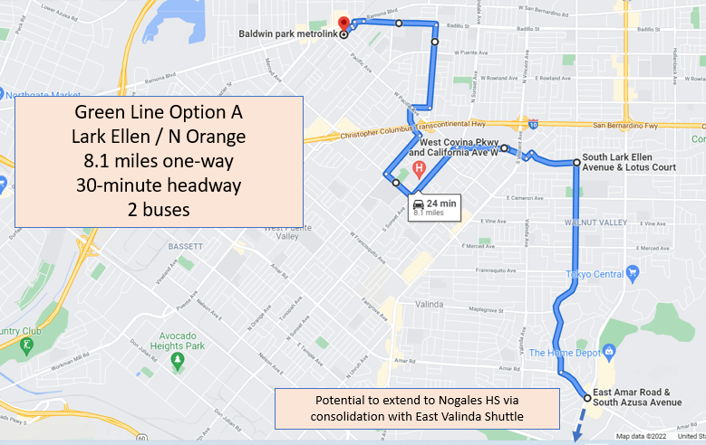
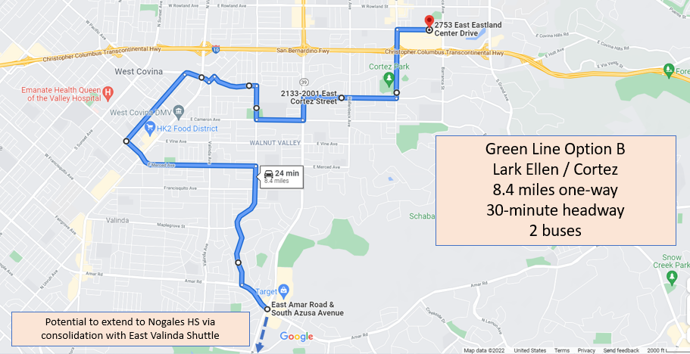
Service Improvement Strategies – Conceptual Alternatives - IDEAS
1. Retain current level of service of Go West Shuttle service
Replace one-way loops with linear alignments and bi-directional service on major streets to reduce travel time
Restructure: two crosstown routes
Extend coverage to Baldwin Park Metrolink
Retain existing Dial-a-Ride service
11

Slide 12

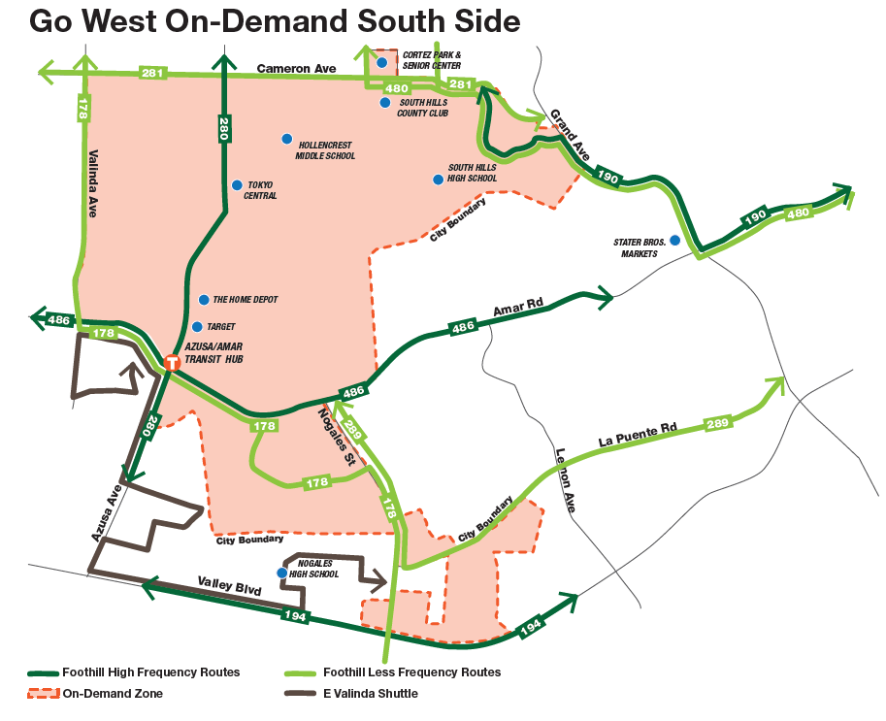
Service Improvement Strategies – Conceptual Alternatives - IDEAS
2. Reduce Go West Shuttle service & Implement South Side On-Demand service
Single cross-town shuttle route (e.g., Workman, Orange corridors
Replace Go West Green route with On-Demand microtransit service
Focus on first-last mile connections with Foothill Transit
Coordinate with Dial-a-Ride to expand customer choice & increase operating efficiencies
12

Slide 13
Service Improvement Strategies – Conceptual Alternatives - IDEAS
3. Phase out Go West Shuttle service and transition to citywide microtransit
Discontinue existing shuttle network
Provide citywide (multi-zone) first mile-last mile microtransit connections to Foothill Transit high-frequency bus lines at key transfer points
Coordinate with LADPW to consolidate East Valinda Shuttle service and funding
Coordinate microtransit service delivery with Dial-a-Ride to expand ADA-eligible customer choice and increase operating effectiveness
13

Slide 14
Service Improvement Strategies – Conceptual Alternatives - IDEAS
4. Discontinue Go West Shuttles and integrate services with Foothill Transit
Discontinue fixed route shuttles
Engage Foothill Transit to Plan to advance high-frequency network within West Covina
Increase frequency of Line 178 between Puente Hills and Baldwin Park Metrolink from 30 minutes to 15 minutes.
Increase frequency of Line 281 between Eastland Center and S Sunset Avenue at Francisco Avenue from 30 minutes to 15 minutes .
Operate a consistent 15-minute headway on Line 280
Retain Dial-a-Ride as a contract service
14

Slide 15
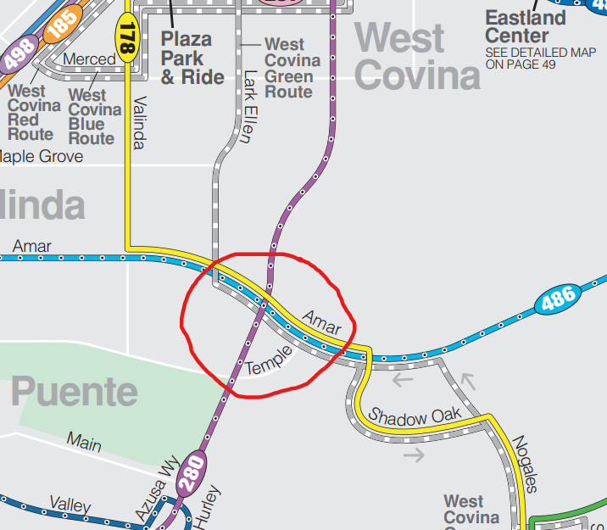
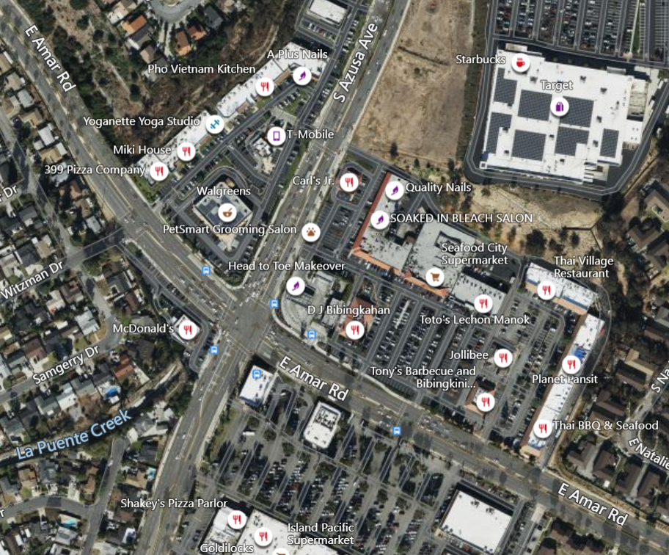
Service Improvement Strategies – recommendation
Develop a transfer hub within the Azusa-Amar retail area
Served by three Foothill high frequency lines connecting in all directions – 178, 280, 486
Operate Go West Shuttle or microtransit services
15

Slide 16
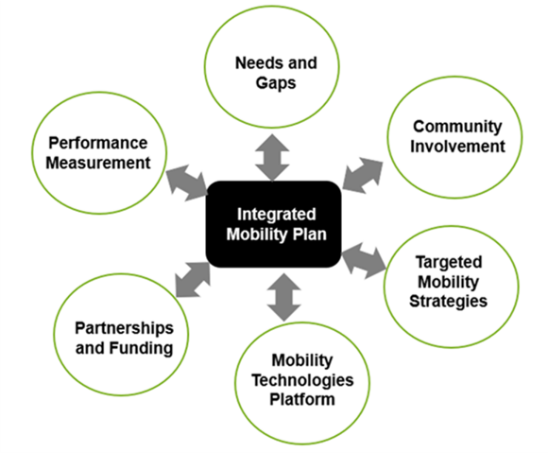
We Need Your Input!
ISSUES & CHALLENGES ?
  What works well? And not so well?
TRAVEL NEEDS & REQUIREMENTS ?
  Unmet Needs?
Your Thoughts on Conceptual Alternatives?
Restructure Go West Shuttle routes?
South Side On-Demand Microtransit Service?
What kind of service is justified for the City? (Future service requirements?)
  TARGETED MOBILITY SOLUTIONS?
16

Slide 17
Transit Service Evaluation
City of West Covina
THANK
YOU
February 2022

Slide 18
Alternate Route Configuration - IDEAS
18

Slide 19
Alternate Route Configuration - IDEAS
19

Slide 20
Alternate Route Configuration - IDEAS
20

Slide 21
On-Demand – South Side
21

Slide 22
Operating statistics & Key Performance Indicators
Go West Shuttle Operating Statistics and Key Performance Indicators, FY 2019-2021
22

Slide 23
Operating statistics & Key Performance Indicators
Dial-A-Ride Operating Statistics and Key Performance Indicators, FY 2019-2021
23

Slide 24
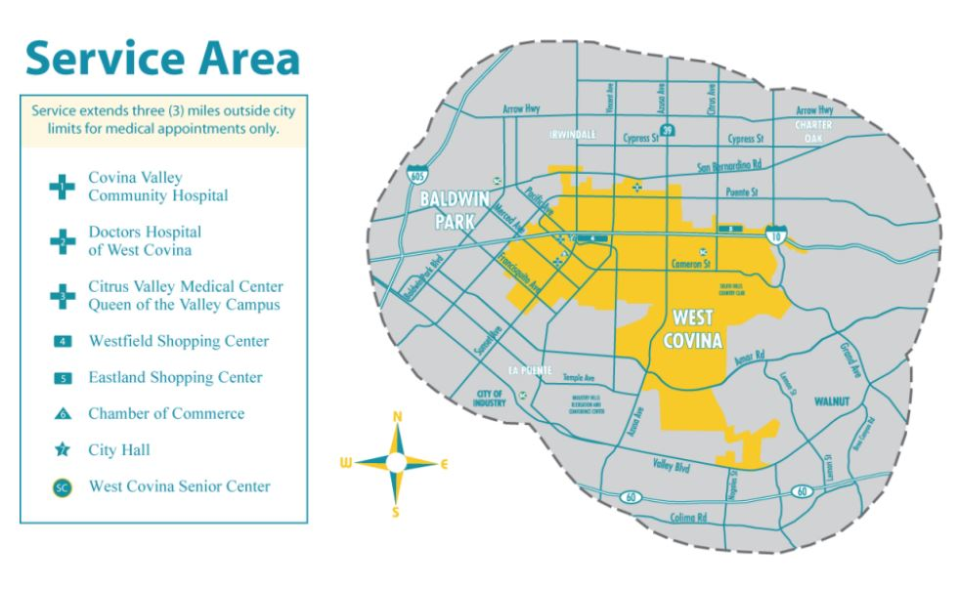

We Need Your Input! (Dial-A-Ride)
“When barriers get in the way of people with disabilities participating fully in society as a result of their disabilities, everyone loses.”
What do you think about?
Eligibility criteria?
Availability of service?
Advance booking requirements?
On-time performance? Service reliability?
Travel times?
Fares?
Passenger information?
Ease of booking a trip?
Technology - opportunities? A mobile phone app for real-time information?
24

