Slide 1
City of West Covina Redistricting 2021 Public Hearing #4
National Demographics Corporation

Slide 2
Tonight’s Agenda
The 2021 redistricting process
Project timelines
Key deadlines
Next steps and hearings
Review of Draft Map

Slide 3
Ordinance Introduction Hearing
At the March 1, 2022 hearing, the West Covina City Council reviewed the draft maps and received public testimony on the maps
The City Council chose to move forward with Map 105

Slide 4
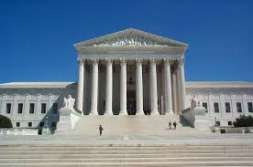
Redistricting Rules and Goals
1. Federal Laws
2. California Criteria
for Cities
3. Other Traditional Redistricting Principles
Equal Population
Federal Voting Rights Act
No Racial Gerrymandering
Geographically contiguous
Undivided neighborhoods and “communities of interest” (Socio-economic geographic areas that should be kept together)
Easily identifiable boundaries
Compact (Do not bypass one group of people to get to a more distant group of people)
Prohibited:
“Shall not favor or discriminate against a political party.”
Minimize voters shifted to different election years
Respect voters’ choices / continuity in office
Future population growth
Preserving the core of existing districts

Slide 5
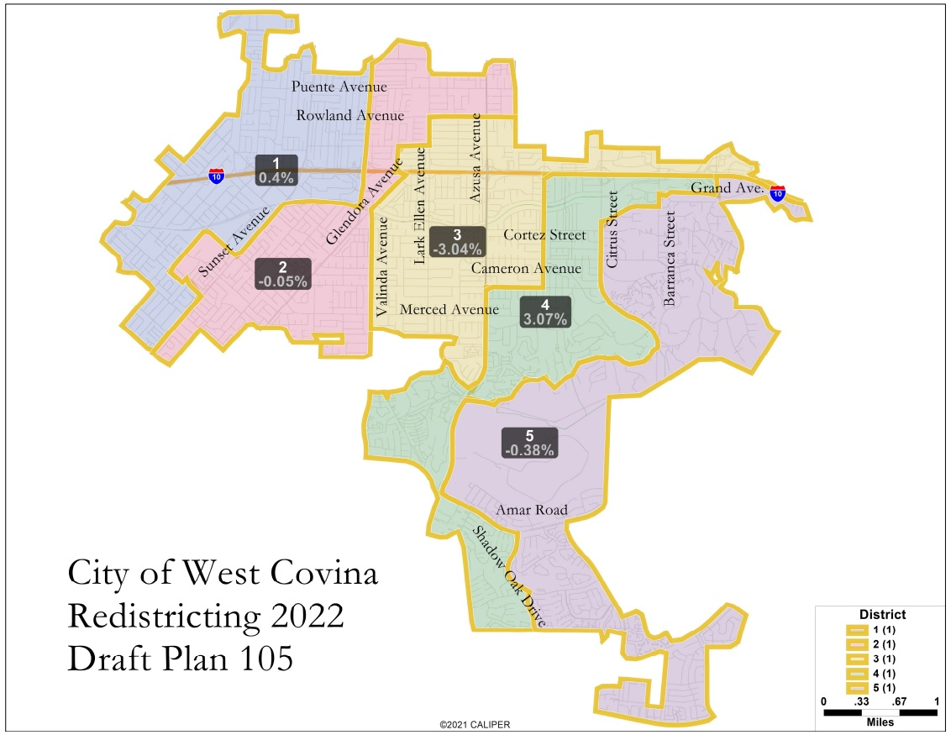
Proposed Map 105

Slide 6
Key Dates and Next Steps
August/September 2021 | Redistricting data available. Census data released in mid-August. California released prisoner-adjusted data late September.
November 18, 2021 | 1st Public Workshop (counts as a hearing for AB 849 requirements)
January 13, 2022 | 2nd Public Hearing
March 1, 2022 | 3rd Public Hearing
March 15, 2022 | Ordinance introduction hearing
April 5, 2022 | Ordinance adoption hearing. Must be completed no later than April 17, 2022.
April 17, 2022 (E-205) | City deadline to adopt and submit map to Registrar
November 2022 | 2022 Election

Slide 7
Remainder of This Evening’s Hearing
Questions regarding the presentation?
Review of draft map and public testimony
Consideration of 1st reading of adoption ordinance.

